Slide 1

BRONCHIAL ASTHMA
Dr K.V.CHALAPATHI RAO
PROFESSOR
DEPARTMENT OF GENERAL MEDICINE

Slide 2
OUT LINE : INRODUCTION. ETIOPATHOGENESIS. CLINICAL FEATURES . DIAGNOSIS.
TREATMENT ( GINA GUIDELINES -2019).

Slide 3
Definition of Asthma
Asthma is a heterogeneous disease, usually characterized by chronic airway inflammation. It is
defined by the history of respiratory symptoms such as wheeze, shortness of breath, chest tightness and cough that vary over time and in intensity, together with variable expiratory airflow limitation.

Slide 4
Risk factors
ENDOGENOUS FACTORS .
Genetic predisposition. Atopy.
Airway hyper-responsiveness. Gender .
Ethnicity.
Obesity.
Early viral infections.

Slide 5
ENVIRONMENTAL FACTORS :
Indoor allergens. Outdoor allergens. Occupational sensitizers. Passive smoking.
Respiratory infections.
Air pollution (diesel particulates, nitrogen oxides). Diet
Dampness and mold exposure . acetaminophen

Slide 6
Factors that trigger asthma symptoms:
Viral infections.
Allergens at work or home(house dust mite, pollens, cockroach).
Exercise and hyperventilation.
Cold air.
Stress.
Tobacco smoke.
Drugs(NSAID s, aspirin, Beta blockers).
Sulfur dioxide and irritant gases (household sprays ,paint fumes).

Slide 8
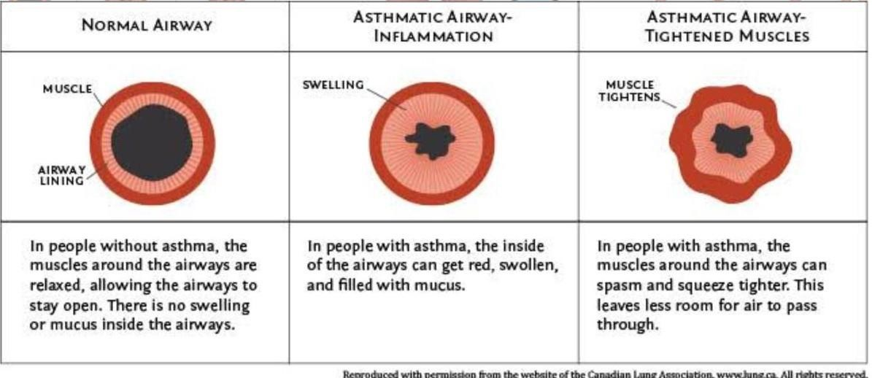

Slide 9
PATHOPHYSIOLOGY
Players in pathophysiology of asthma : Dendritic cells .
Eosinophils . mast cell
IgE antibodies.
T helper cells-TH2

Slide 11
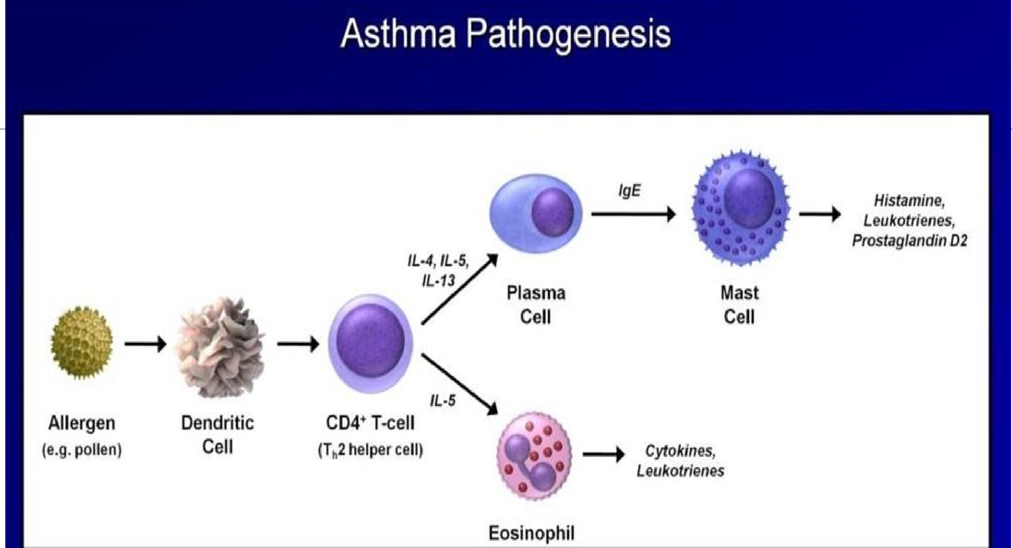

Slide 12
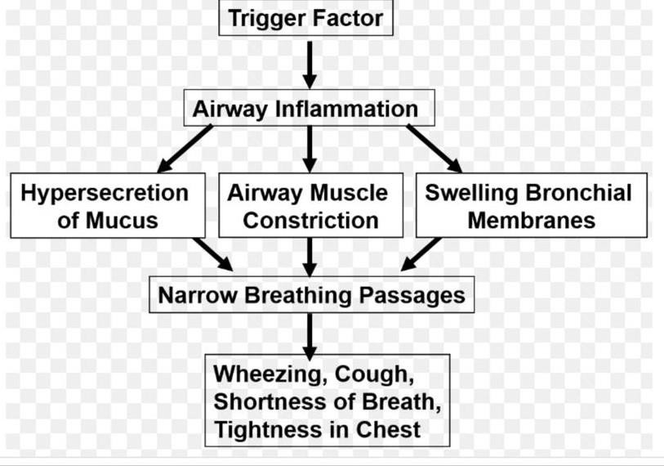

Slide 14
CLINICAL FEATURES:
Characteristic symptoms of asthma are wheezing ,dyspnoea and coughing. Symptoms variable.
Prodromal symptoms- itching under the chin, discomfort between scapulae and inexplicable fear.
SIGNS : typical inspiratory ronchi and to a greater extent expiratory ronchi .

Slide 15
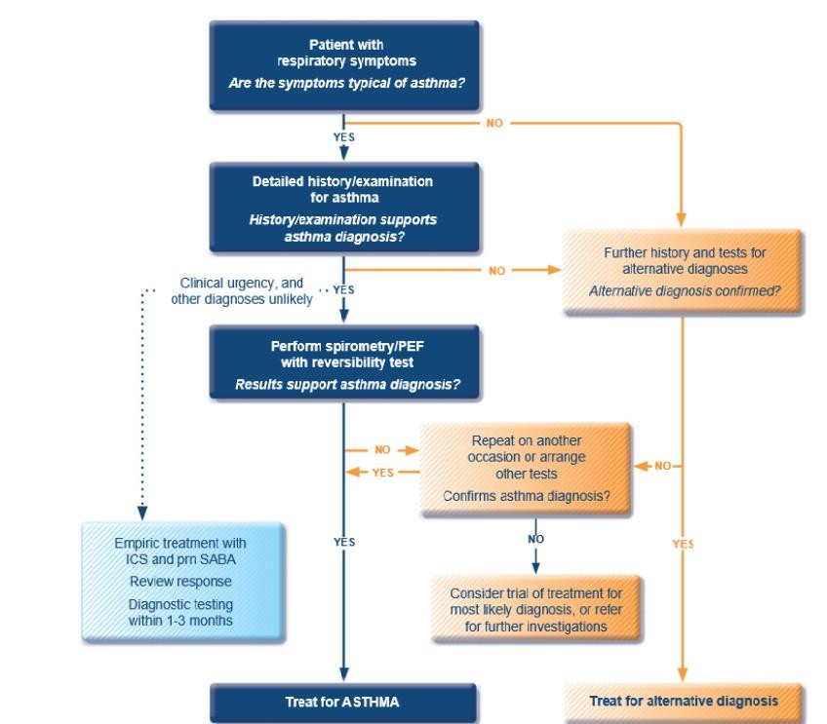
Making diagnosis of Asthma:

Slide 16
Asthma phenotypes:
Allergic asthma
Non-allergic asthma
Late onset asthma
Asthma with fixed airflow limitation
Asthma with obesity

Slide 17
Criteria for Diagnosis of asthma:
1. History of variable respiratory symptoms:
More than one type of symptom (wheeze, shortness of breath, cough, chest tightness)
Symptoms often worse at night or in the early morning
Symptoms vary over time and in intensity
Symptoms are triggered by viral infections, exercise, allergen exposure, changes in weather, laughter, irritants such as car exhaust fumes, smoke, or strong smells

Slide 18
EVIDENCE OF VARIABLE EXPIRATORY AIRFLOW LIMITATION:
Confirm presence of airflow limitation
  Document that FEV₁/FVC is reduced (at least once, when FEV₁ is low)
  FEV₁/ FVC ratio is normally >0.75 – 0.80 in healthy adults, and
>0.90 in children
Confirm variation in lung function is greater than in healthy individuals
  The greater the variation, or the more times variation is seen, the greater probability that the diagnosis is asthma
  Bronchodilator reversibility (adults: increase in FEV₁ >12% and >200mL; children: increase >12% predicted)
  Significant increase in FEV₁ or PEF after 4 weeks of controller treatment
  Bronchodilator reversibility may not be present during severe exacerbations and viral infections.

Slide 19
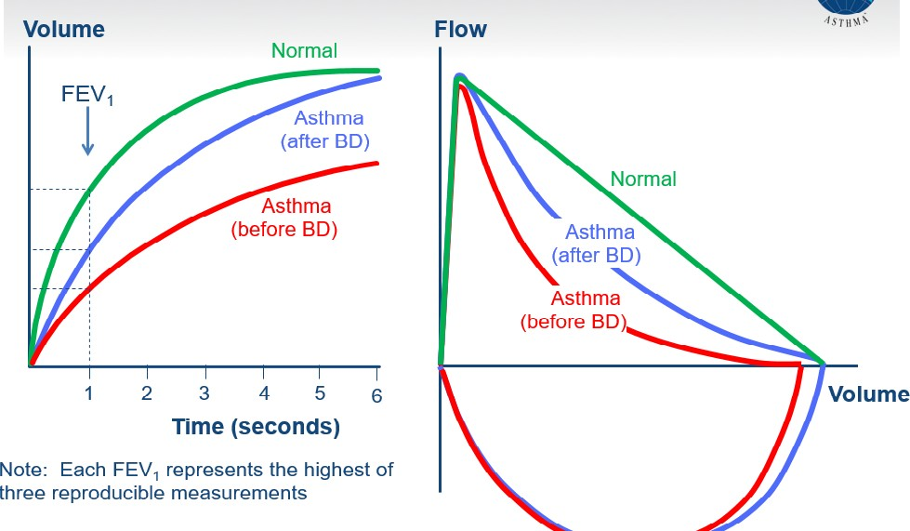
Typical spirometric tracings

Slide 20
Investigations
Hematologic test: serum IgE . IMAGING : usually normal .
hyperinflated lungs
CT - may show areas of bronchiectasis in severe asthma.

Slide 21
Diagnosing asthma in other contexts
Occupational asthma- Every patient with adult-onset asthma should be asked about occupational exposure and whether they are better when away from work
Pregnancy
The elderly: Asthma is usually either under-diagnosed or over diagnosed
Smokers: Asthma and COPD may co exist and overlap particularly in COPD and elderly
Patients with cough as only respiratory symptom: DD- Chronic upper airway cough syndrome (post nasal drip), GERD, Vocal cord dysfunction, eosinophilic bronchitis, Cough variant asthma-(cough + airway hyper responsiveness +variability in lung function)

Slide 22
Assessing a patient with Asthma
Asthma control - two domains
  Assess symptom control over the last 4 weeks
  Assess risk factors for poor outcomes, including low lung function
Treatment issues
  Check inhaler technique and adherence
  Ask about side-effects
  Does the patient have a written asthma action plan?
  What are the patient’s attitudes and goals for their asthma?
    Comorbidities
      Think of rhinosinusitis, GERD, obesity, obstructive sleep apnea, depression, anxiety
      These may contribute to symptoms and poor quality of life

Slide 23
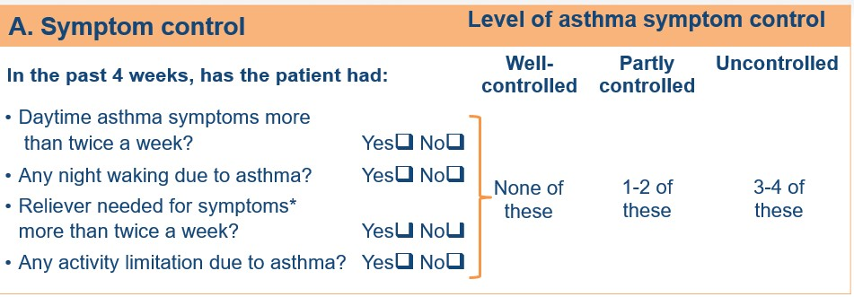
GINA Assessment of symptom control

Slide 24
GINA Assessment of Risk factors
Assess risk factors at diagnosis and periodically
Measure FEV₁ at start of treatment, after 3 to 6 months of treatment to record the patient’s
personal best, then periodically for ongoing risk assessment
MODIFIABLE RISK FACTORS:
Medication : no ICS prescribed, poor adherence, improper inhaler technique
Co-morbidities
Exposure :smoke, allergen, pollution
Settings
Lung function: Low FEVI (<60% Predicted) , high reversibility
Other tests: sputum/blood eosinophilia, FENO

Slide 25
Major independent risk factors for flare-ups:
Ever being intubated or in ICU for asthma
Having 1 or more exacerbations in last 12c months
Risk factors for fixed airflow limitation:
Preterm, LBW
Lack of ICS particles
Exposure to noxious particles
Low FEV1
Chronic mucus hypersecretion
Sputum/ blood eosinophilia

Slide 26
Role of lung function in monitoring asthma:
Lung function should be recorded at diagnosis, 3-6 months after starting treatment and
periodically thereafter(every 1-2 years)
More frequent in children, and in those who have higher risk of flare –ups and decline in lung function

Slide 27
Assessment of asthma severity
Currently asthma severity is retrospectively assessed from the level of treatment required to
control symptoms and exacerbations
Mild asthma- asthma that is controlled with Step 1 or Step 2 treatment
Moderate asthma-well controlled with step 3
Severe asthma- requires Step 5 treatment or remains uncontrolled even after step 5

Slide 28
Management of asthma

Slide 30
General principles:
The long-term goals of asthma management are
Symptom control
Risk reduction
Aims of asthma management:
To minimize future risk of exacerbations, asthma related deaths,fixed airflow limitation and medication side-effects

Slide 31
Treatment to prevent asthma exacerbations and control symptoms:
Medications- GINA recommends every adult and adolescent with asthma should receive ICS containing controller medication to reduce risk of serious exacerbations ,even in patient with infrequent symptoms
Treat modifiable risk factors and co-morbidities
Non-pharmacological therapy

Slide 32
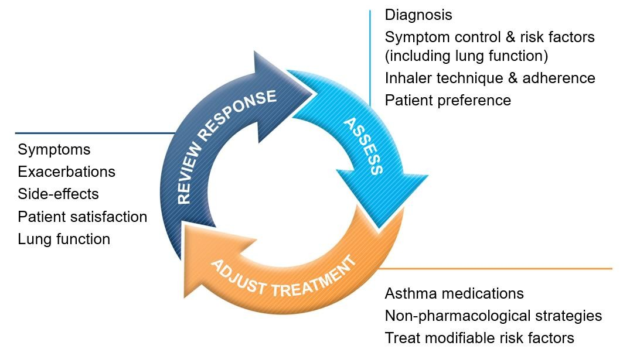
Control based Asthma management test:

Slide 33
Background to changes in 2019 - the risks of SABA-only treatment
Regular or frequent use of SABA is associated with adverse effects :
b-receptor downregulation, decreased bronchoprotection, rebound hyperresponsiveness, decreased bronchodilator response.
Increased allergic response, and increased eosinophilic airway inflammation
Higher use of SABA is associated with adverse clinical outcomes :
Dispensing of ≥3 canisters per year (average 1.7 puffs/day) is associated with higher risk of
emergency department presentations.
Dispensing of ≥12 canisters per year is associated with higher risk of death.

Slide 34
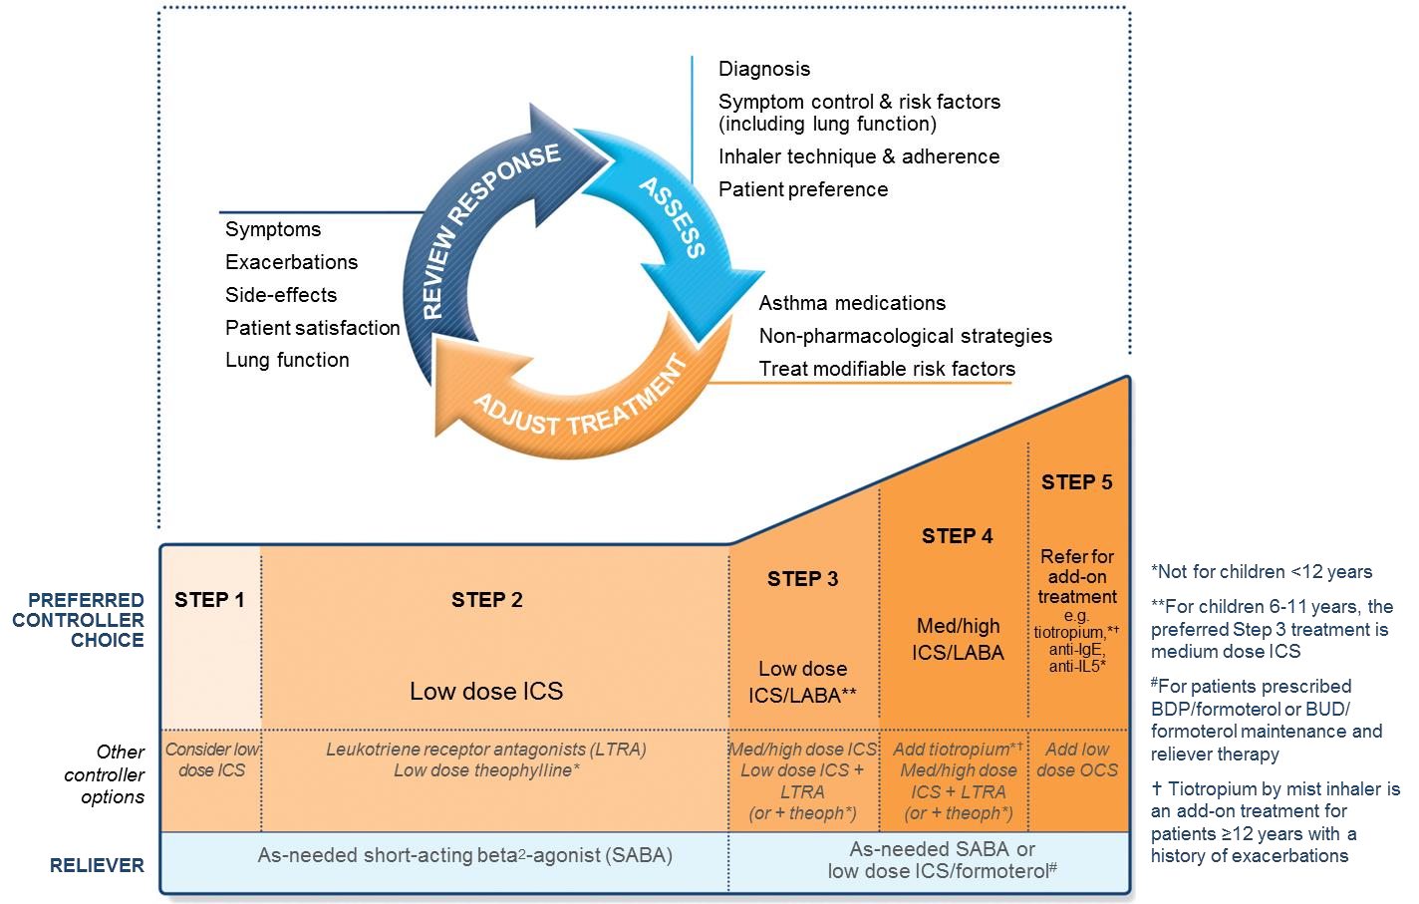




GINA 2018 – main treatment figure
Step 1 treatment is for
patients with symptoms
<twice/month and no risk
factors for exacerbations
Previously, no controller was
recommended for Step 1, i.e. SABA-only
treatment was ‘preferred’

Slide 35
GINA 2019 – landmark changes in asthma management
For safety, GINA no longer recommends SABA-only treatment for Step 1
This decision was based on evidence that SABA-only treatment increases the risk of severe exacerbations, and that adding any ICS significantly reduces the risk
GINA now recommends that all adults and adolescents with asthma should receive symptom- driven or regular low dose ICS-containing controller treatment, to reduce the risk of serious exacerbations

Slide 36
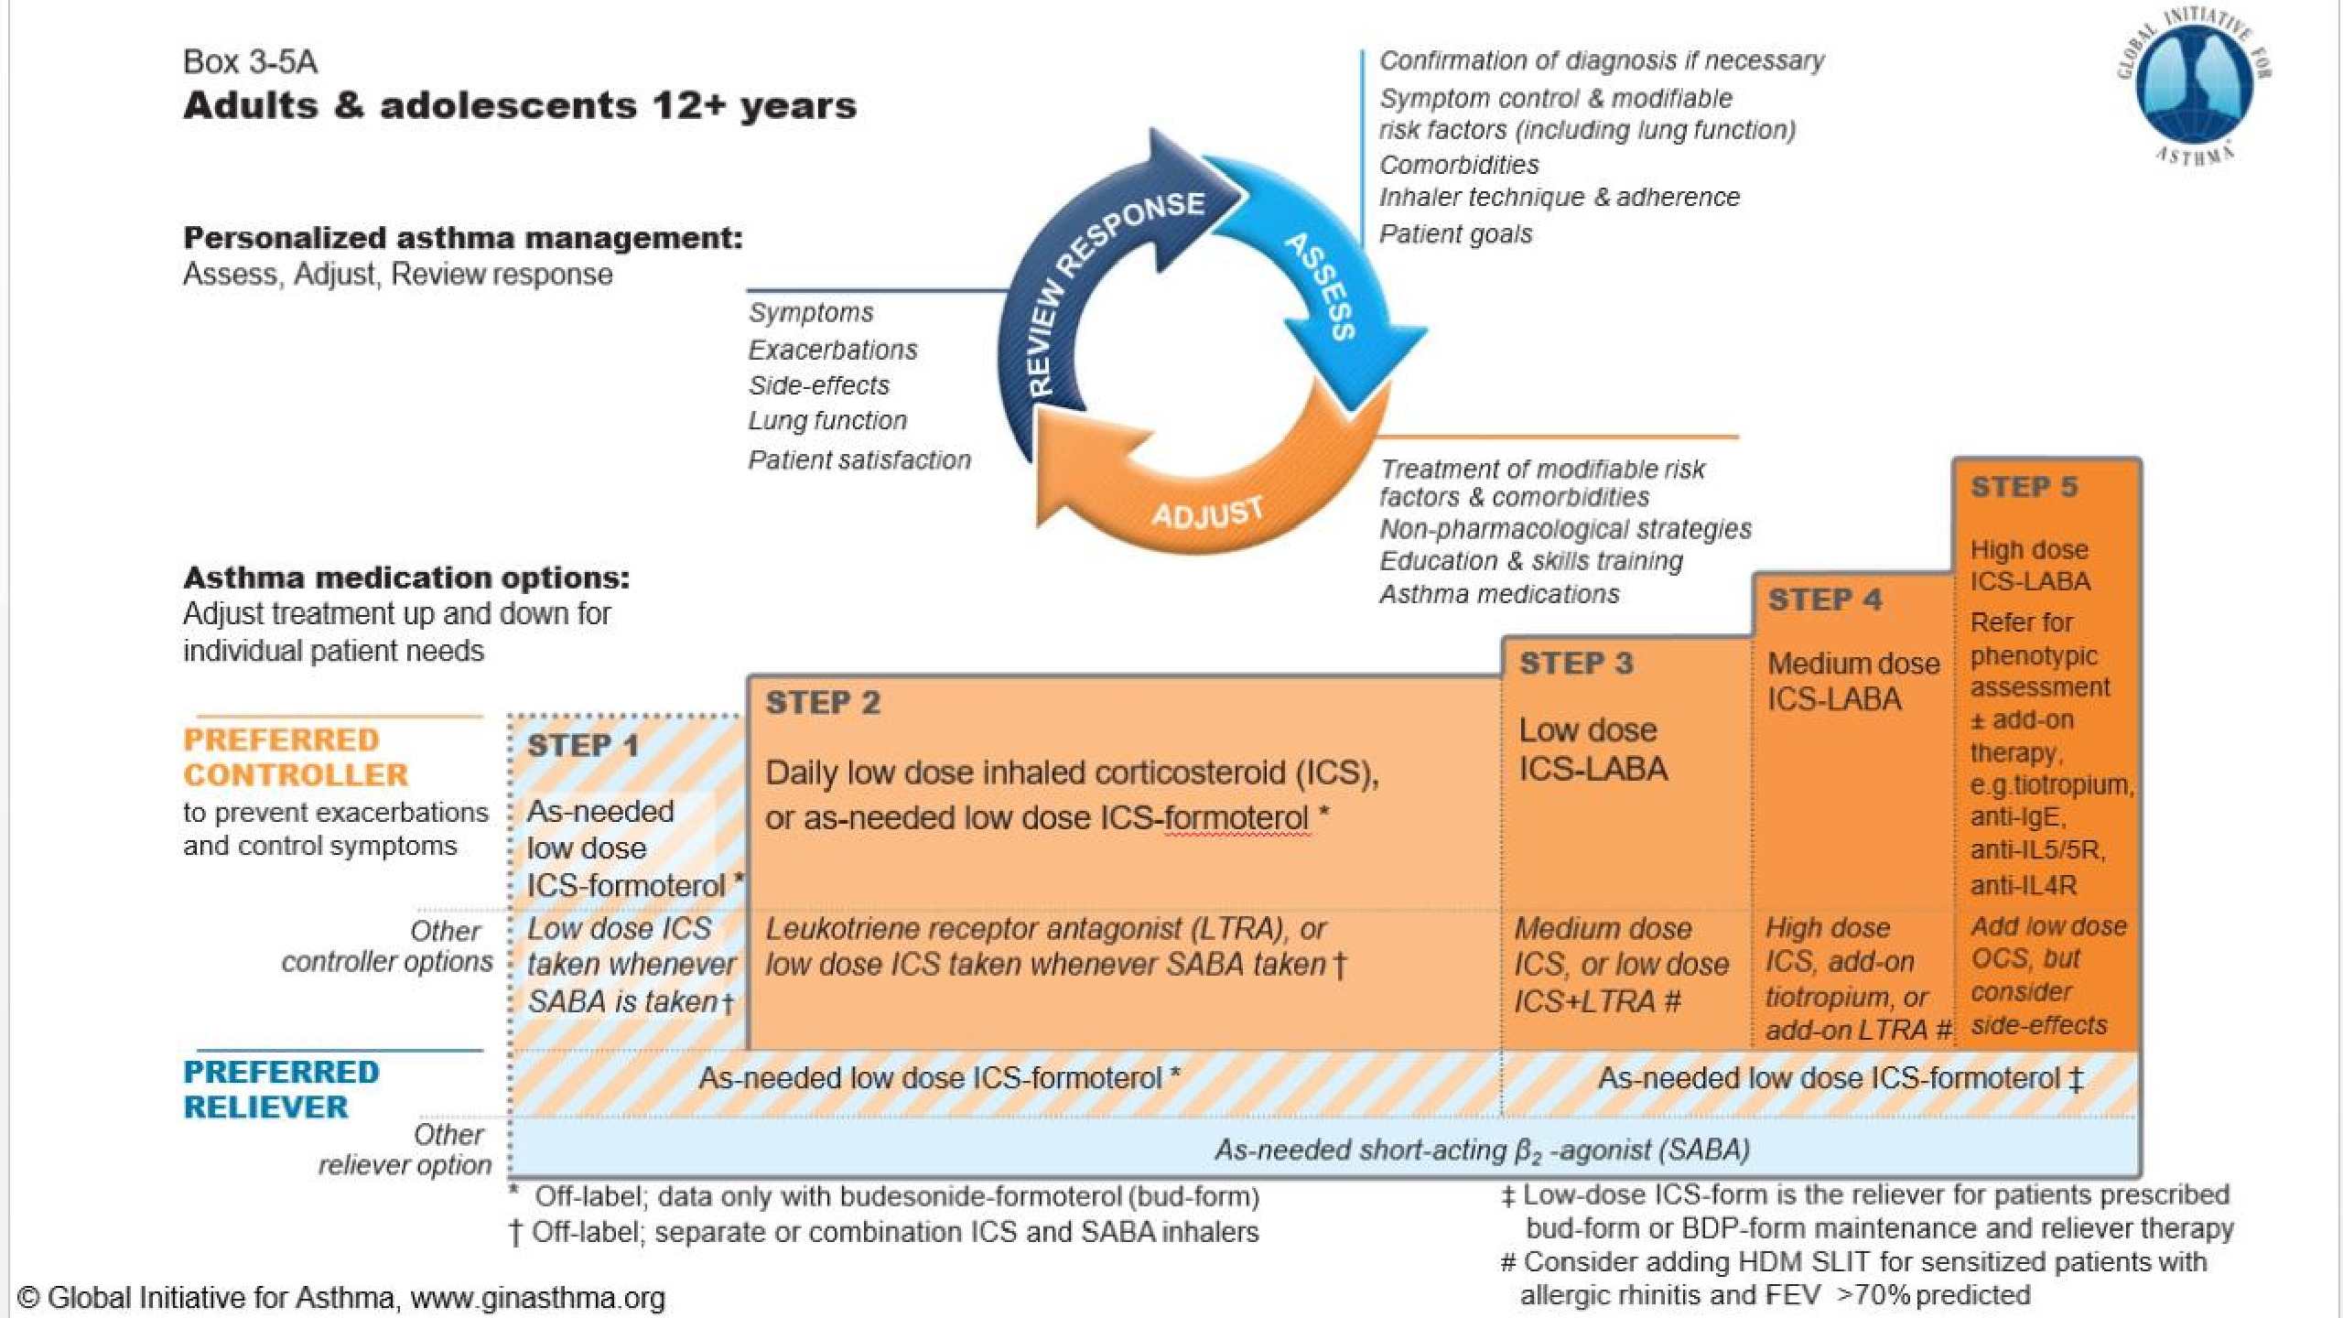

Slide 37
INHALED CORTICOSTEROID | LOW | MEDIUM | HIGH
Beclomethasone dipropionate(CFC) | 200-500 | >500-1000 | >1000
Beclomethasone dipropionate(HFA) | 100-200 | >200-400 | >400
Budesonide | 200-400 | >400-800 | >800
Ciclesonide | 80-160 | >160-320 | >320
Fluticasone furoate | 100 | - | 200
Fluticasone propionate(DPI) | 100-250 | >250-500 | >500
Fluticasone propionate(HFA) | 100-250 | >250-500 | >500
Momentasone furoate | 110-220 | >220-440 | >440
Triamcinolone acetonide | 400-1000 | >1000-2000 | >2000

Slide 38
Stepwise Asthma management:
Provide guided self-management education
Treat modifiable risk factors and comorbidities
Advise about non-pharmacological therapies and strategies
Consider stepping up if … uncontrolled symptoms, exacerbations or risks,
but check diagnosis, inhaler technique and adherence first
Consider adding SLIT in adult HDM-sensitive patients with allergic rhinitis who have exacerbations despite ICS treatment, provided FEV₁ is 70% predicted
Consider stepping down if … symptoms controlled for 3 months
+ low risk for exacerbations. Ceasing ICS is not advised

Slide 39
Step- 1
Preferred controller-As needed low dose ICS-Formoterol(off-label)
Recommendations are for patients with symptoms less than twice a month and no exacerbation risk factors

Slide 40
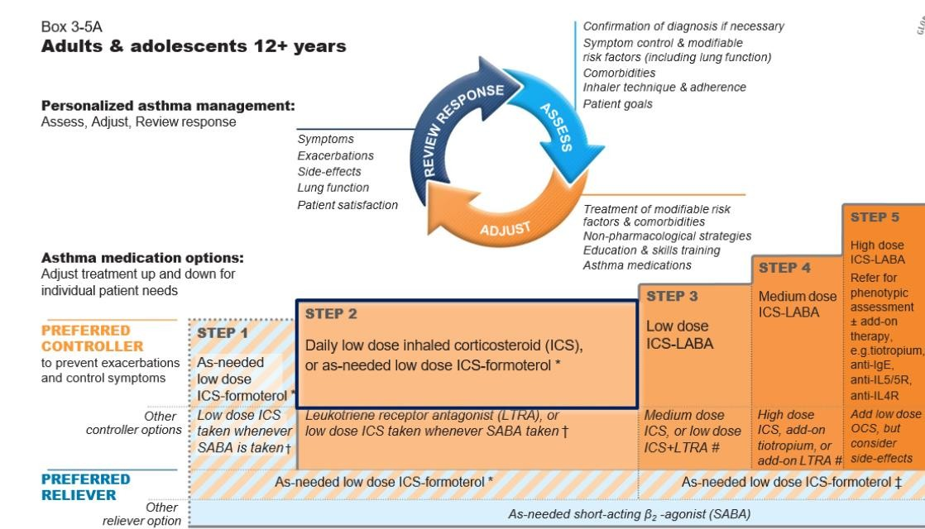

Slide 41
Step-2
Two preferred controller options:
Daily low dose ICS with as needed SABA
As-needed low dose ICS

Slide 42
Other Controller options:
Low dose ICS whenever SABA is taken
  To prevent severe exacerbations
  Lower importance given to small differences in symptom control and the inconvenience of needing to carry two inhalers
  Combination ICS-SABA inhalers are available in some countries, but approved only for maintenance use
2. Leukotriene receptor antagonist: less effective for exacerbation

Slide 43
Step 3:
Preferred controller-
1.
2.
low dose ICS –LABA maintenance plus as needed SABA ,or low dose ICS-Formoterol maintenance and reliever therapy
Step 3 unchanged from 2018.
Other controller:
Medium dose ICS
Low dose ICS+LTRA
Adult patients with rhinitis + allergic to house dust mite- consider SLIT (if predicted FeV1>70%)

Slide 44
Step 4:
Preferred controller :
low dose ICS-Formoterol as maintenance and reliever therapy
Medium dose ICS-LABA maintenance plus as needed SABA
Other controller:
Add on tiotropium by mist inhaler for patients > 6 years with a H/O exacerbation
Increasing to high dose ICS-LABA Consider SLIT

Slide 45
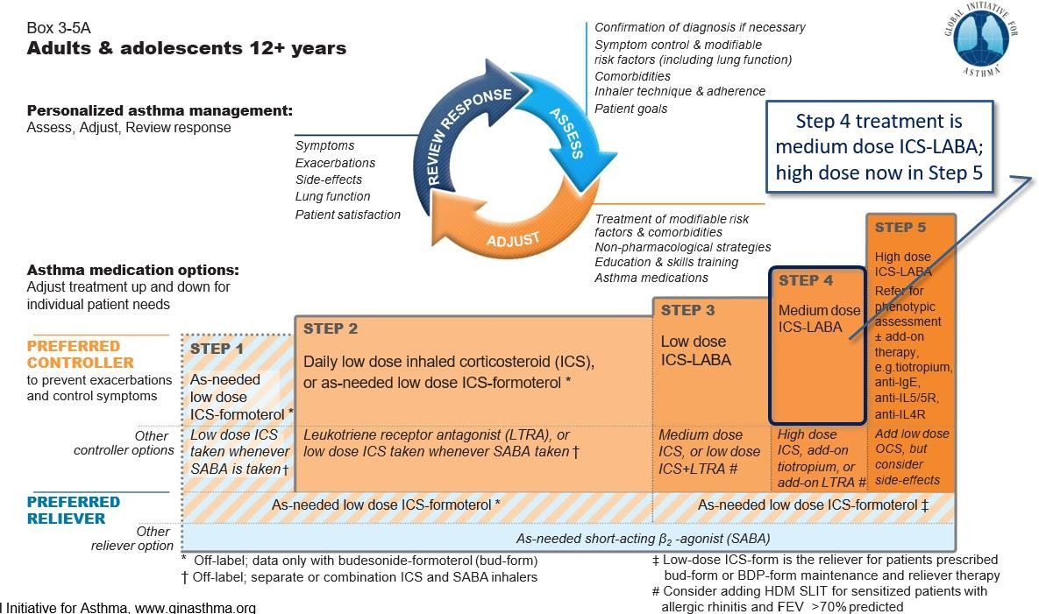

Slide 46
Step 5:
Preferred option is referral for specialist investigation and consideration of add-on treatment
If symptoms uncontrolled or exacerbations persist despite Step 4 treatment, check inhaler technique and adherence before referring
Add-on tiotropium for patients ≥6 years with history of exacerbations
Add-on anti-IgE (omalizumab) for patients with severe allergic asthma
Add-on anti-IL5 (mepolizumab (SC) or reslizumab (IV)) for severe eosinophilic asthma (≥12 yrs)
Add-on anti-IL5R(Benralizumab(SC) >12 yrs)
Add-on anti IL4R(Dupilumab(SC)> 12 yrs)
Other add-on treatment options at Step 5 include:
Sputum-guided treatment: this is available in specialized centers; reduces exacerbations and/or corticosteroid dose
Add-on low dose oral corticosteroids (≤7.5mg/day prednisone equivalent)

Slide 47
How often should asthma be reviewed?
1-3 months after treatment started, then every 3-12 months
During pregnancy, every 4-6 weeks
After an exacerbation, within 1 week
Stepping up asthma treatment
Sustained step-up, for at least 2-3 months if asthma poorly controlled
Important: first check for common causes (symptoms not due to asthma, incorrect inhaler technique, poor adherence)
Short-term step-up, for 1-2 weeks, e.g. with viral infection or allergen May be initiated by patient with written asthma action plan
Day-to-day adjustment
For patients prescribed low-dose ICS/formoterol maintenance and reliever regimen

Slide 48
Stepping down- Aim
To find the lowest dose that controls symptoms and exacerbations, and minimizes the risk of side-effects
When to consider stepping down
When symptoms have been well controlled and lung function stable for ≥3 months
No respiratory infection, patient not travelling, not pregnant
Prepare for step-down
Record the level of symptom control and consider risk factors
Make sure the patient has a written asthma action plan
Book a follow-up visit in 1-3 months
Stepping down ICS doses by 25–50% at 3 month intervals is feasible and safe for most patients
Stopping ICS is not recommended in adults with asthma because of risk of exacerbations

Slide 49
Inhaler skills and adherence
Inhaler skills:
CHOOSE
CHECK
CORRECT
CONFIRM
Check and improve adherence

Slide 50
Treating modifiable risk factors:
Guided self management
Use of a regimen that minimises exacerbations
Avoidance of exposure to tobacco smoke
Severe asthma- refer to specialist centre
Appropriate food avoidance

Slide 51
Non-pharmacological therapies
Smoking cessation advice
Physical activity
Identify and remove occupational sensitisers
Ask about NSAIDs including Aspirin

Slide 52
Written asthma –action plan:
The action plan should include:
The patient’s usual asthma medications
When/how to increase reliever and controller or start OCS
How to access medical care if symptoms fail to respond
Increase inhaled reliever
Increase frequency as needed, Adding spacer for pMDI may be helpful
Early and rapid increase in inhaled controller
Up to maximum ICS of 2000mcg BDP/day or equivalent
Options depend on usual controller medication and type of LABA
Add oral corticosteroids if needed
Adults: prednisolone 1mg/kg/day up to 50mg, usually 5-7 days
Children: 1-2mg/kg/day up to 40mg, usually 3-5 days
Tapering not needed if taken for less than 2 weeks
Remember to advise patients about common side-effects (sleep disturbance, increased appetite, reflux, mood changes)

Slide 53
Managing exacerbations in primary care

Slide 54
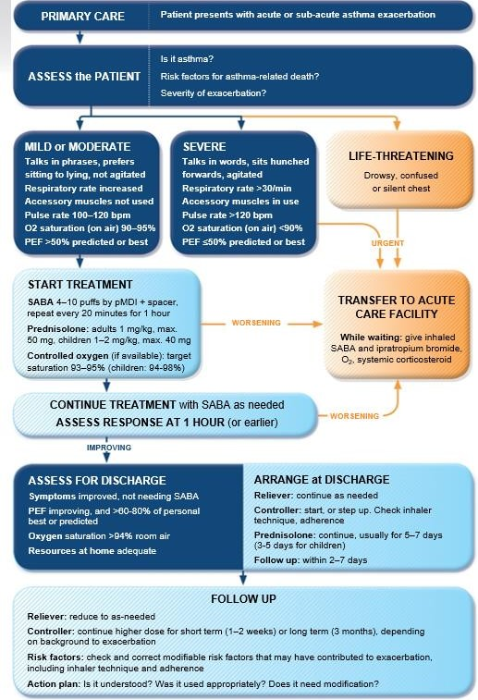

Slide 55
Managing exacerbations in acute care settings

Slide 56
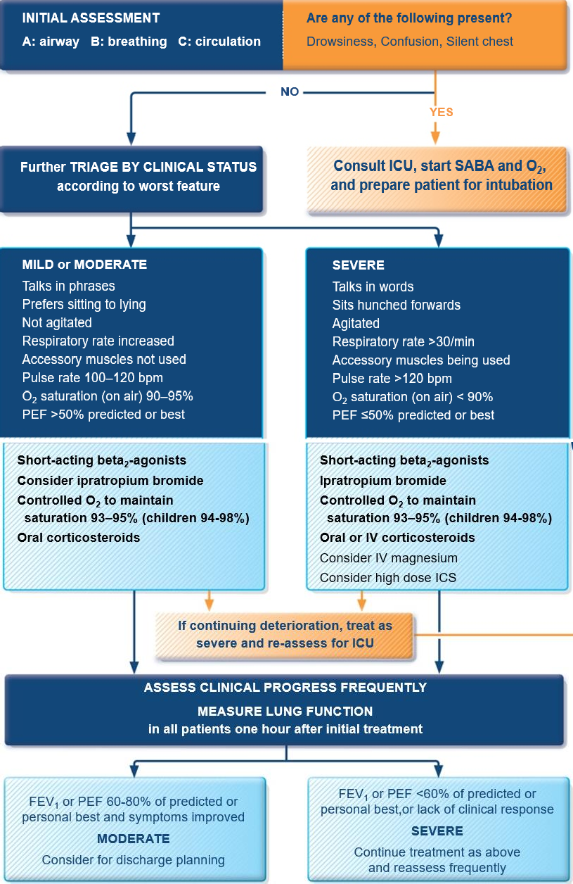

Slide 57
Asthma-COPD overlap
Asthma-COPD overlap (ACO) is characterized by persistent airflow limitation with several features usually associated with asthma and several features usually associated with COPD. Asthma-COPD overlap is therefore identified in clinical practice by the features that it shares with both asthma and COPD.
This is not a definition, but a description for clinical use, as asthma-COPD overlap includes several different clinical phenotypes and there are likely to be several different underlying mechanisms.
Patients with features of both asthma and COPD have worse outcomes than those with asthma
or COPD alone
Frequent exacerbations
Poor quality of life
More rapid decline in lung function
Higher mortality
Greater health care utilization

Slide 58
Summary :
For safety, GINA no longer recommends SABA-only treatment for Step 1
This decision was based on evidence that SABA-only treatment increases the risk of severe exacerbations, and that adding any ICS significantly reduces the risk
GINA now recommends that all adults and adolescents with asthma should receive symptom- driven or regular low dose ICS-containing controller treatment, to reduce the risk of serious exacerbations

Slide 59
THANK YOU

